Slide 1

Data Structure
School of Computer Science and Engineering
South China University of Technology
张见威
课程QQ群：数据结构-22秋张老师 627840641

Slide 2
课程安排与要求
学时
总学时：64，授课：48，上机16
MOOC和作业网址: scut.yuketang.cn
考核：
60%期末笔试，40%平时（包括MOOC学习、作业、OJ平台实验、OJ上机考试）

Slide 3
课程安排与要求
过程管理：
每周在QQ群上发下周任务（以及对应的MOOC章节），同学们提前看视频，并做完每小节后的题目。
课后完成每章的作业（在每章最后，用“第X章”为标题。
第3，5，7，9，11，14，15，16周周四上午3，4节在B3-138上机，平台网址：https://course.educg.net
请大家按时完成作业，过期不能补交（我是认真的）

Slide 4
教学目标
完成课程后，学生将具备以下能力：
1. 掌握线性表、树与二叉树、图等基础数据结构，以及掌握分析算法时间复杂度和空间复杂度的方法。
2. 能够灵活应用数据结构知识，对现实中的工程问题进行分析，对适用的数据结构以及算法进行对比论证。
3. 能够设计针对计算机工程复杂问题的解决方案，设计满足特定需求的数据结构和算法，并能够在设计环节中体现创新意识。具有较复杂计算机系统研发基本能力，具备问题分析和建模的能力。

Slide 5
课程简介
数据结构是计算机学科各专业的一门重要专业基础课程。
本课程主要论述数据的逻辑结构、存储结构、算法设计以及算法评价四方面的内容，使学生对线性表、栈、队列、树、图等各种数据结构以及查找、排序等基础算法有深入的了解；
还要求学生针对具体的工程问题，系统地掌握在不同的数据结构上进行有关算法设计的思想和技巧。数据结构是一门理论性和实践性都很强的课程。

Slide 6
学习方法
注重实践 （作业、实验课、论计算机专业学生的自身修养。。。）
英文课本、英文作业、英文考试
英文关反正要过，迟过不如早过！
英文单词就那么多，会一个少一个！
平时认真扎实，切忌考前突击

Slide 7
上述例子的启示
数据如何存放和组织，与以下因素有关
任务（只是堆放？还是为了快速查找）
你的资源（比如存储空间）
数据存储和操作紧密相关
数据的组织是为了更高效地完成任务
不同的存储结构，操作也不同
数
据
结
构
逻辑结构
物理结构
算法

Slide 8
这门课关心什么
分析问题：完成什么任务？有多少资源？
设计数据结构：如何定义数据之间的逻辑关系，如何存储数据，才能高效完成任务？
设计算法：在设计好的数据结构中，如何操作才能高效完成任务？
不同的数据结构和算法，哪种更好？如何评判优劣？
再有其他任务，我如何解决上述问题？

Slide 9
1. What is data structure?
a data structure is a particular way of storing and organizing data in a computer so that it can be used efficiently.
Different kinds of data structures are suited to different kinds of applications.

Slide 10
Some example (1)
Digital Library.
001 | 高等数学 | 樊映川 | 机械工业出版社 | …
002 | 理论力学 | 罗远祥 | 电子工业出版社 | …
003 | 高等数学 | 华罗庚 | 高等教育出版社 | …
004 | 线性代数 | 栾汝书 | 高等教育出版社 | …
… | … | … | … | …
Data structure:
List

Slide 11
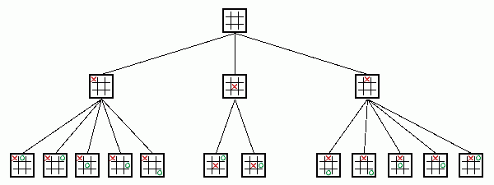
Some example (2)
Game: Gobang(五子棋), Chess, TicTacToe（井字棋）
Data structure:
Tree

Slide 12

Some example (3)
Social network
Data structure:
Graph

Slide 13
2.How to present Data structures?
In different Languages, there are different forms of implementation of the similar data structures.
Abstract Data Type (ADT): is a language independent model to describe data structures.
ADT is defined in terms of a set of values and a set of operations on the data.

Slide 14
Only about input and output.
No detail about implementation .
Example of ADT
template <class Elem>
class List {
public:
virtual void clear() = 0;
virtual bool insert(const Elem&) = 0;
virtual bool append(const Elem&) = 0;
virtual bool remove(Elem&) = 0;
virtual void setStart() = 0;
virtual void setEnd() = 0;
virtual void prev() = 0;
virtual void next() = 0;
}

Slide 15
Implementation of data structures
Implementation of a data structure described as an ADT:
Decide how to store and organize the data.
Decide how to implement the operations.
Each operation associated with the ADT is implemented by one or more subroutines in the implementation.

Slide 16
Example of Data structure
template <class Elem> // Array-based list
class AList : public List<Elem> {
private:
int maxSize; // Maximum size of list
int listSize; // Actual elem count
int fence; // Position of fence
Elem* listArray; // Array holding list
public:
… … … …
void clear() {
delete [] listArray;
listSize = fence = 0;
listArray = new Elem[maxSize];
}
void setStart() { fence = 0; }
… … … …
Implementation
of data storage
Implementation
of operations

Slide 17
3. What is algorithm
Algorithm: a method or a process followed to solve a problem.
An algorithm takes the input to a problem (function) and transforms it to the output.
A mapping of input to output.
A problem can have many algorithms.

Slide 18
Algorithm Properties
An algorithm possesses the following properties:
It must be correct.
It must be composed of a series of concrete steps.
There can be no ambiguity as to which step will be performed next.
It must be composed of a finite number of steps.
It must terminate.
Notes:
“Correct” means computes the proper function.
“Concrete steps” are executable by the machine in question.
We frequently interchange use of “algorithm” and “program” though they are actually different concepts.

Slide 19
4. Data structure vs Algorithm
Data structures + algorithms = Programs !!
Data structures focus on the how to store and organize the application data
Algorithms focus on how to process the data to solve some problems
Data structures and algorithms have strong correlation.

Slide 20
5. How to select efficient Data structures and algorithms?
An algorithm is said to be efficient if it solves the problem within its resource constraints.
Space
Time
The choice of data structure and algorithm can make the difference between a program running in a few seconds or many days.
Notes:
If you are willing to pay enough in time delay. Example: Simple unordered array of records.

Slide 21
Selecting a Data Structure
Select a data structure as follows:
Analyze the problem to determine the resource constraints a solution must meet.
Determine the basic operations that must be supported. Quantify the resource constraints for each operation.
Select the data structure that best meets these requirements.
Notes:
Typically want the “simplest” data structure that will meet the requirements.

Slide 22
Some Questions to Ask when selecting
Are all data inserted into the data structure at the beginning, or are insertions interspersed with other operations?
Can data be deleted?
Are all data processed in some well-defined order, or is random access allowed?
Notes:
These questions often help to narrow the possibilities.
If data can be deleted, a more complex representation is typically required.

Slide 23
Preliminaries
Chapter1
Data Structures and Algorithms
Chapter2
Mathematical Preliminaries
Chapter3
Algorithm Analysis

Slide 24
Chapter 2. Mathematical Preliminaries
Set (集合)concepts and notation.
Recursion (递归)
Induction Proofs （归纳证明）
Logarithms （对数公式）
Summations （求和公式）
Notes:
Look over Chapter 2, read as needed depending on your familiarity with this material.
A set has no duplicates, a sequence may have duplicates.
Logarithms: We almost always use log to base 2. That is our default base.

Slide 25
Chapter 3. Algorithm Analysis
Why we need algorithm analysis?
Growth rate Analysis
Asymptotic Algorithm Analysis
3.1 Big-Oh
3.2 Big-Omega
3.3 Theta notation
3.4 Simplifing rules
Problem analysis

Slide 26
1. Why we need Algorithm Analysis
Two (sometimes conflicting) goals of programming:
To design an algorithm that is easy to understand, code, debug.
2. To design an algorithm that makes efficient use of the computer’s resources.
Design pattern, Software engineering
Algorithm analysis
measurement of the algorithm efficiency

Slide 27
Chapter 3. Algorithm Analysis
Why we need algorithm analysis?
Growth rate Analysis
Asymptotic Algorithm Analysis
3.1 Big-Oh
3.2 Big-Omega
3.3 Theta notation
3.4 Simplifing rules
Problem analysis

Slide 28
2. Growth rate Analysis
Methods to measure the algorithm efficiency:
Empirical comparison (run programs)
Growth rate Analysis
Analyze how the cost (Time, Space) grows when increasing the size of the input.
T(n) : The Running Time as a function on the input size n.
S(n): The used space as a function on the input size n.
Notes:
Empirical comparison is difficult to do “fairly” and is time consuming.
Critical resources: Time. Space (disk, RAM). Programmers effort. Ease of use (user’s effort).
Factors affecting running time: Machine load. OS. Compiler. Problem size. Specific input values for given problem size.

Slide 29
Examples 1
// Find largest value
int largest(int array[], int n) {
int currlarge = 0; // Largest value seen
for (int i=1; i<=n; i++) // For each val
if (array[currlarge] < array[i])
currlarge = i; // Remember pos
return currlarge; // Return largest
}
T(n)=c₁n+c₂
Notes:
As n grows, how does T(n) grow?
Cost: T(n) = c₁n + c₂ steps

Slide 30
Examples 2
sum = 0;
for (i=1; i<=n; i++)
for (j=1; j<=n; j++)
sum++;
}
T(n)= c₁n² + c₂
Notes:
Example 2: Cost: T(n) = c₁n² + c₂. Roughly n² steps, with sum being n² at the end. Ignore various overhead such as loop counter increments.

Slide 31
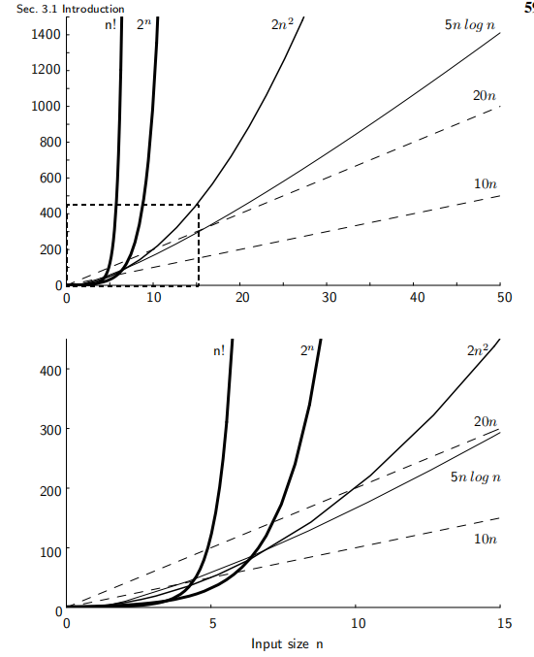
T(n) of different algorithms
书59页

Slide 32
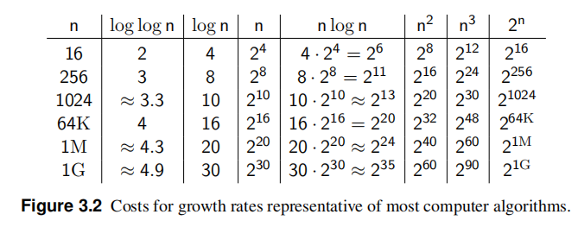
T(n) of different algorithms

Slide 33
Best, Worst, Average Cases
All inputs of a given size take the same algorithm the same time to run?
WRONG!!
Example: Sequential search for K in an array of n integers:
Best case:
Worst case:
Average case:
Find at first position: 1 compare
Find at last position: n compares
(n+1)/2 compares
Notes:
Best: Find at first position. Cost is 1 compare.
Worst: Find at last position. Cost is n compares.
Average: (n+1)/2 compares IF we assume the element with value K is equally likely to be in any position in the array.

Slide 34
A Common Misunderstanding
“The best case for my algorithm is n=1 because that is the fastest.”
WRONG!
Best case is defined as which input of size n is cheapest among all inputs of size n.

Slide 35
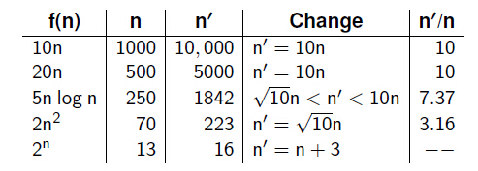
A Faster Computer, or a Faster Algorithm?
Notes:
Example picture size: 256 colors (8 bits), 1000 by 1000 pixels.

Slide 36
Chapter 3. Algorithm Analysis
Why we need algorithm analysis?
Growth rate Analysis
Asymptotic Algorithm Analysis
3.1 Big-Oh
3.2 Big-Omega
3.3 Theta notation
3.4 Simplifing rules
Problem analysis

Slide 37
3. Asymptotic Analysis
T(n) usually has complex expression with multiple parameters.
Ex: T(n) = c₁n²+ c₂logn + ….
Asymptotic analysis is used to simplify the measurement while capturing the asymptotic trend of T(n) .
Big-Oh
Big-Omega
Theta
Notes:
Must pick one of [best, average, worst] to complete the statement. Big-oh notation applies to some set of bounds.

Slide 38
3.1 Big-Oh (1)
Definition: For T(n) a non-negatively valued function, T(n) is in the set O(f(n)) if there exist two positive constants c and n₀ such that T(n) ≤ cf(n) for all n > n₀.
Meaning: For all data sets big enough (i.e., n>n₀), the algorithm always executes in less than cf(n) steps.
Example: The running time of a algorithm is in O(n²) in [best, average, worst] case.

Slide 39
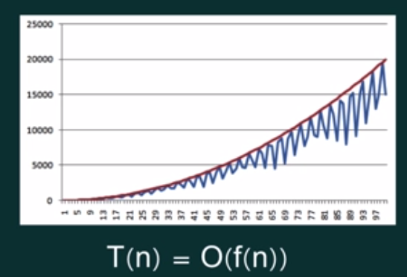
Big-Oh

Slide 40
Big-Oh (2)
Big-oh notation indicates an upper bound.
Ex: If T(n) = 3n² then T(n) is in O(n²).
Multiple upper bounds exist for a T(n).
EX: T(n) = 3n² is also in O(n³).
Tightest upper bound is preferred to analyze the algorithm:
O(n²) is preferred.
Notes:
It provides more information in this example to say O(n²) than O(n³).

Slide 41
Big-Oh Examples (1)
Example 1: The average cost to find the value X in an array.
T(n) = c₀(n+1)/2.
For all values of n > 1, T(n) =c₀(n+1)/2 ≤ c₀n.
Therefore, by the definition, T(n) is in O(n) for n₀ = 1 and c = c₀.
Notes:
We are doing average case.
c₀ is a constant. The actual value is irrelevant.

Slide 42
Big-Oh Examples (2)
Example 2: T(n) = c₁n² + c₂n in average case.
T(n ) =c₁n² + c₂n ≤ c₁n² + c₂n² ≤ (c₁ + c₂)n² for all n > 1.
Therefore, T(n) is in O(n²) by the definition for c = c₁ + c₂ and n₀ = 1.
Example 3: T(n) = c. We say this is in O(1).

Slide 43
3.2 Big-Omega
Definition: For T(n) a non-negatively valued function, T(n) is in the set Ω(g(n)) if there exist two positive constants c and n₀ such that T(n) ≥ cg(n) for all n > n₀.
Meaning: For all data sets big enough (i.e., n > n₀), the algorithm always executes in more than cg(n) steps.
Lower bound.

Slide 44
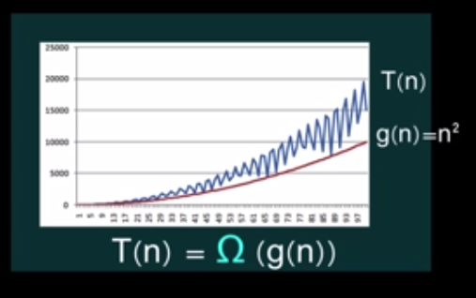
Big-Omega

Slide 45
Big-Omega Example
Example: T(n) = c₁n² + c₂n.
T(n)= c₁n² + c₂n ≥ c₁n² for all n > 1.
Therefore, T(n) is in Ω(n²) by the definition for c = c₁ and n₀ = 1.

Slide 46
3.3 Theta Notation
When big-Oh and Ω meet, we indicate this by using Θ (big-Theta) notation.
Definition: An algorithm is said to be Θ(h(n)) if it is in O(h(n)) and it is in Ω(h(n)).
Notes:
For polynomial equations on T(n), we always have Θ. There is no uncertainty, since once we have the equation, we have a “complete” analysis.

Slide 47
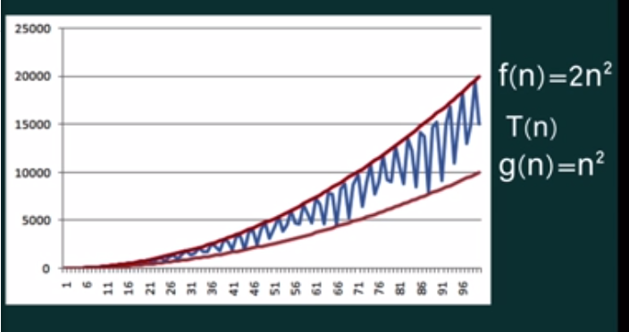
Big-Theta

Slide 48
3.4 Simplifying Rules
If f(n) is in O(g(n)) and g(n) is in O(h(n)), then f(n) is in O(h(n)).
If f(n) is in O(kg(n)) for any constant k > 0, then f(n) is in O(g(n)).
If f₁(n) is in O(g₁(n)) and f₂(n) is in O(g₂(n)), then f₁ (n) + f₂(n) is in O(max(g₁(n), g₂(n))).
If f₁(n) is in O(g₁(n)) and f₂(n) is in O(g₂(n)) then f₁(n)f₂(n) is in O(g₁(n)g₂(n)).
These rules also holds true for Ω and Θ.
Notes:
2. Ignore constants.
3. Drop low order terms.
4. Useful for analyzing loops.

Slide 49
Examples (1)
Example 1: a = b;
This assignment takes constant time, so it is Θ(1).
Example 2:
sum = 0;
for (i=1; i<=n; i++)
sum += n;
T(n)=c₁n+c₂
⇒ cost is Θ(n)
Notes:
Asymptotic analysis is defined for equations. We need to convert programs to equations to analyze them.
The traditional notation is Θ(1), not Θ(c).
Θ(n) even though the value of sum is n².

Slide 50
Examples (2)
Example 3:
sum = 0;
for (i=1; i<=n; i++) //first loop
for (j=1; j<=i; j++) //double loop
sum++;
for (k=0; k<n; k++) //second loop
A[k] = k;
First statement is Θ(1).
Double loop is Σi= Θ(n²).
Final loop is Θ(n).
Result: Θ(n²).
Notes:
First statement is Θ(1). Double for loop is Σi = Θ(n²). Final for loop is Θ(n). Result: Θ(n²).

Slide 51
Examples (3)
Example 4:
sum1 = 0;
for(i=1;i<=n;i++)//first double loop
for(j=1;j<=n;j++)//do n times
sum1++;
sum2 = 0;
for(i=1;i<=n;i++)//second double loop
for(j=1;j<=i;j++)//do i times
sum2++;
First loop, sum is n². Second loop, sum is (n+1)n/2.
Both are Θ(n²).
Notes:
First loop, sum is n². Second loop, sum is (n+1)(n)/2. Both are Θ(n²).

Slide 52
Examples (4)
Example 5:
sum1 = 0;
for (k=1; k<=n; k*=2)
for (j=1; j<=n; j++)
sum1++;
sum2 = 0;
for (k=1; k<=n; k*=2)
for (j=1; j<=k; j++)
sum2++;
First is = Θ(nlog n).
Second is = Θ(n).
Notes:
First loop is Σn for k = 1 to log n, or Θ(n log n).
Second loop is Σ2^{k} for k = 0 to log n - 1, or Θ(n).

Slide 53
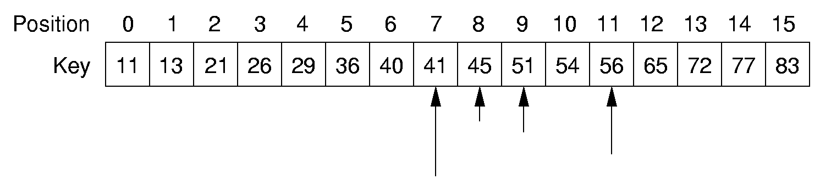
Examples (5) : Binary Search
l
r
search 45
// Return position of element in sorted
// array of size n with value K.
int binary(int array[], int n, int K) {
int l = -1;
int r = n; // l, r are beyond array bounds
while (l+1 != r) { // Stop when l, r meet
int i = (l+r)/2; // Check middle
if (K < array[i]) r = i; // Left half
if (K == array[i]) return i; // Found it
if (K > array[i]) l = i; // Right half
}
return n; // Search value not in array
}

Slide 54
Examples (5) : Binary Search(cont.)
Analysis:
Spent time in the worst case?
T(1)= c (c > 0) (1)
T(n)=T(n/2)+c (n>1) (2)
From (1)(2), we have T(n)=c(logn+1) . T(n) is in Θ(logn) .
Comparison:
Sequential search
average case: T(n)= (n+1)/2 cost is Θ(n)
worst case: T(n)=n cost is Θ(n)

Slide 55
Example (6) : Multiple Parameters
Compute the rank ordering for all C pixel values in a picture of P pixels.
for (i=0; i<C; i++) // Initialize count
count[i] = 0;
for (i=0; i<P; i++) // Look at all pixels
count[value(i)]++; // Increment count
sort(count); // Sort pixel counts
If we use P as the measure, then time is Θ(P log P). (because C<= P)
More accurate is Θ(P + C log C).
Notes:
Example picture size: 256 colors (8 bits), 1000 by 1000 pixels.

Slide 56
Chapter 3. Algorithm Analysis
Why we need algorithm analysis?
Growth rate Analysis
Asymptotic Algorithm Analysis
3.1 Big-Oh
3.2 Big-Omega
3.3 Theta notation
3.4 Simplifing rules
Problem analysis

Slide 57
4. Problems Analysis
A problem can be solved in multiple algorithms with different efficiency.
Upper bound of a problem:
Upper bound of best known algorithm.
Lower bound of a problem:
Lower bound for every possible algorithm. Even algorithms that we have not thought of.
Notes:
Analyzing problems is done a lot in a senior algorithms class.

Slide 58
Example:
Example: Sorting Problem
1. Bubble or insertion sort: O(n²).
2. better sort (Quicksort, Mergesort, Heapsort, etc.): O(n log n).
3. Thus, sorting is O(n log n). (upper bound)
4. We can also prove later that sorting is Ω(n log n). (lower bound)
Notes:
The examples so far have been easy in that exact equations always yield Θ. Thus, it is hard to distinguish Ω and O. This example should help to explain the difference. Bounds are used to describe our level of uncertainty about an algorithm.

Slide 59
Space Analysis
Be similar to those used to measure time requirements.
space/time trade-off
lookup table-sin, cos, etc
two sorting algorithm
for ( i=0; i<n; i++)
B[A[i]] = A[i];
for (i = 0; i<n; i++)
while (A[i] != i) swap(A, i, A[i]);
Notes:
The examples so far have been easy in that exact equations always yield Θ. Thus, it is hard to distinguish Ω and O. This example should help to explain the difference. Bounds are used to describe our level of uncertainty about an algorithm.

Slide 60
Goals of this Course
Learn the commonly used data structures.
These form a programmer's basic data structure.
Understand how to measure the cost of a data structure or program.
These techniques also allow you to judge the merits of new data structures that you or others might invent.
Reinforce the concept that costs and benefits exist for every data structure.
Notes:
The first goal is a worldview to adopt
The second goal is the “nuts and bolts” of the course.
The third goal prepares a student for the future.

